Slide 1
4.2 Assembly Language
Show understanding of the relationship between assembly language and machine code
Describe the different stages of the assembly process for a two-pass assembler
Trace a given simple assembly language program
Show understanding that a set of instructions are grouped
Modes of addressing
Apply the two-pass assembler process to a given simple assembly language program
Including the following groups:
Data movement
Input and output of data
Arithmetic operations
Unconditional and conditional instructions
Compare instructions Including Immediate, direct, indirect, indexed, relative

Slide 2
Today
1. Show understanding of the relationship between assembly language and machine code
3. Show understanding of the relationship between assembly language and machine code
4. Trace a given simple assembly language program
5. Show understanding that a set of instructions are grouped
Understand: What is assembly language
Able: How it connects to machine code
Answer: What are opcodes and operands?

Slide 3
What is assembly language?
Question:
What language can a computer understand? Answer:
Binary. Only 1 and 0, electricity on, electricity off
Question:
Why don’t we (humans) write code in Binary?
Answer:
We can, but OMG its too long and complicated and difficult
01000010 01100001 01110100 01101101 01100001 01101110 is the same as saying Batman

Slide 4
HLL vs LLL vs Machine
All languages are split into two categories
High Level Language
Low Level Language
High Level Language (HLL) is stuff that is similar to English, C++, Python, JAVA, HTML, Visual Basic – all are languages that are close to English and are HLL.
All HLL languages need to be converted by an interpreter or compiler into Machine Code.
Low Level Languages (LLL)
This is where it become stupid…. There are two LLL. Assembly Language and Machine Code
Assembly language uses words that also look like English, and these also need to be translated into Machine Code. But Assembly language is translated using an Assembler.
Machine code. All HLL gets converted into Machine code. All Assembly language gets converted into machine code. All machine code is, is code that the computer can directly understand. It’s same as binary

Slide 5
What’s the difference?
If HLL looks like English and needs to be translated into Machine code
And
Assembly language looks like English and needs to be translated into Machine Code.
What’s the difference? The both look like English, they both need to be translated, why is Assembly language a Low Level Language?

Slide 6
Assembly Language
Assembly language is classed as a low level language for no real reason.
But its common to think that its an LL because one line of assembly Language is one instruction.
So for example:
HLL you can have a + b
But in Assembly its:
LOAD A
STORE A
LOAD B
ADD A
(In fact we did B + A)
So with the HLL we can do several operations on a single line but with Assembly its one line does one thing

Slide 7
Terms
Sometimes Assembly Language is called Assembly or ASM.
Each instruction is made up of two halves.
Opcode
Operand
Opcode is what you want to do with the data
Operand is the data you want to do it with
Example
ADD 7
My opcode is ADD
My operand is 7
KILL Bill
Opcode is KILL
Operand is Bill

Slide 8
What codes can I use?
The codes you can use in ASM are called its instruction set
Each assembly language program is written just for that particular computer architecture. Many computers, now, share the same architecture, but in the past one ASM program would only work on your computer and no anyone else’s.
So how do you know what codes Cambridge want you to use?
They tell you. Here is the instruction set for Cambridge ASM

Slide 9
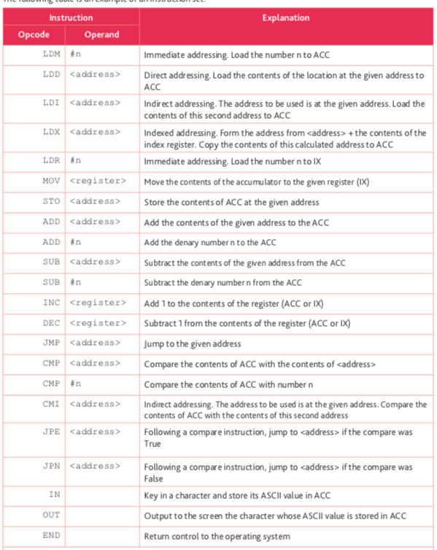

Slide 11
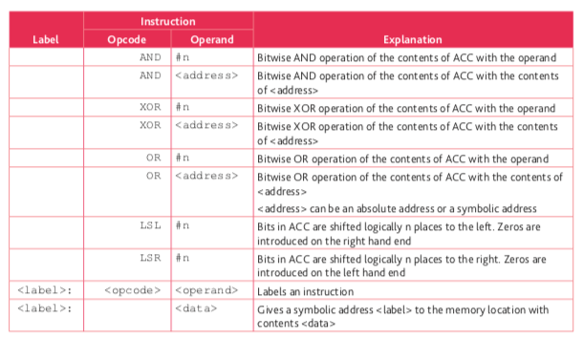

Slide 12
Let’s make a ASM program
Repeat this:
Amar, we all hate you.
You remember how Cambridge has their instruction set, well to help make you actually produce assembly language we will use a website, but this website has different instruction sets.

Slide 13
LMC Codes
So
506 means Load whatever is memory block 4
Add 09 means Add whatever is in memory block 9
Numeric | Mnemonic | Instruction
1xx | ADD | Add
2xx | SUB | Subtract
3xx | STA | Store
5xx | LDA | Load
6xx | BRA | Branch (unconditional)
7xx | BRZ | Branch is Zero
8xx | BRP | Branch if positive
901 | INP | Input
902 | OUT | Output
000 | HLT/COB | Halt / Coffee Break
 | DAT | Data Loads value in the next available box

Slide 14
Numeric | Mnemonic | Instruction
1xx | ADD | Add
2xx | SUB | Subtract
3xx | STA | Store
5xx | LDA | Load
6xx | BRA | Branch (unconditional)
7xx | BRZ | Branch is Zero
8xx | BRP | Branch if positive
901 | INP | Input
902 | OUT | Output
000 | HLT/COB | Halt / Coffee Break
 | DAT | Data Loads value in the next available box

Slide 15
Example Code
Mnemonic | Numeric Machine Code | Description
INP | 901 | Input
STA FIRST | 308 | Store value in position 8
INP | 901 | Input
STA SECOND | 309 | Store value in position 9
LDA FIRST | 508 | Load position 8
ADD SECOND | 109 | Add the value in position9
OUT | 902 | Output
HLT | 0 | Halt (Stop)
FIRST DAT | 0 | Position of first item of data
SECOND DAT | 0 | Position of second item of data

Slide 16
LMC Task
Practice to add two numbers in LMC
http://peterhigginson.co.uk/LMC/
INP
STA FIRST
INP
STA SECOND
LDA FIRST
ADD SECOND
OUT
HLT
FIRST DAT
SECOND DAT

Slide 17
Task
You done one number add another number (a+b), now try:
First number add a second number add a third add a fourth (a+b+c+d)
First add second minus third ((a+b) – c)
One number multiplied by another (a * b)

Slide 18
Advanced LMC Task 2
Create a program that does the following:
LDA ONE
STA COUNT
OUT
LOOPTOP LDA COUNT
ADD ONE
OUT
STA COUNT
SUB TEN
BRP ENDLOOP
BRA LOOPTOP
ENDLOOP HLT
ONE DAT 001
TEN DAT 010
COUNT DAT

Slide 19
Advanced LMC Task 3
Create a program that outputs the numbers 10 to 1 in that order
LDA COUNT
LOOP BRZ END
OUT
SUB ONE
STA COUNT
BRA LOOP
END HLT
COUNT DAT 10
ONE DAT 1

Slide 20
Advanced LMC Task 4
Create a program where a user enters a number and the program counts from that number up to 20
INP
STA COUNT
OUT
LOOPTOP LDA COUNT
ADD ONE
OUT
STA COUNT
SUB TWENTY
BRP ENDLOOP
BRA LOOPTOP
ENDLOOP HLT
ONE DAT 001
TWENTY DAT 020
COUNT DAT

Slide 21
Today
2. Describe the different stages of the assembly process for a two-pass assembler
5. Modes of addressing
6. Apply the two-pass assembler process to a given simple assembly language program
7. Including the following groups:
8. Data movement
9. Input and output of data
10. Arithmetic operations
11. Unconditional and conditional instructions
12. Compare instructions 13. Including Immediate, direct, indirect, indexed, relative
Understand: Why are passes?
Able: Trace a two-pass routine
Answer: Why we use two paths

Slide 22
Assembler
So Assembly language is code.
The code is made from two parts
Opcode
Operand
This assembly language code then has to be translated into machine code (binary)
The job of translating assembly language is done by the Assembler.
There are two types of assembler
One Pass Assembler
Two Pass Assembler

Slide 23
One Pass
Okay, this is where Cambridge wants me to explain: “What is a one-pass assembler” but really what they want is about a Load-and-go assembler.
Load-and-go Assembler
You write your assembly code
The assembler looks at each line
Right away it executes each line
+ Fast. Because it does things right away
- Stupid. Because it does not check for errors
- Stupid, no forward referencing

Slide 24
Real one-pass assembler
So if load-and-go is too stupid, then we can use a one pass assembler.
One-pass assembler
Reads all your code one time
As it reads your code it builds two tables. An Opcode Table and a Symbol table
The opcode table just says “oh you typed in 107, it means ADD something”
So ADD is put in the table
We want to add whatever is in memory location 07, so 07 is put in the symbol table
3. When it finishes building the tables, then your code is run
+ Fast, only one pass
+ If there’s any errors it can see
- Cannot handle forward referencing

Slide 25
Two pass assembler
In One Pass if we had the code:
107
It will make two tables. It will look at 107 and say “okay 1 means ADD” so I will put ADD in my opcode table and in my symbol table I will put memory location 07.
It doesn’t actually know what is in memory location 07, it just knows to ADD it.
In two pass assembler. It reads your code twice
The first read is same as one-pass assembler
Then it reads your code again and this time instead of saying “memory location 07” it actually uses the real number inside memory location 07 and puts it in a VALUE table
+ You know more of the actual values you will be working with
+ If memory location 07 actually says “go to location 15” then you can add in the values of location 15 also
+Checks for errors
-Slower than one-pass and load-and-go

Slide 26
Modes of addressing
We just said that if 107 means ADD whatever is in memory location 07, but actually inside memory location 07 is another instruction that says go to location 15, this is actually a type of addressing.
Addressing = How you get to your data
There are many ways to get to your data. These ways are called Addressing Modes
Absolute / Direct Addressing
Symbolic Addressing
Immediate addressing
Relative addressing
Indexed addressing
Indirect Addressing
Now, we have been saying ”memory location” but often addressing is done in registers, so is sometimes called Register Addressing.

Slide 27
Register Addressing
What is a register?
A small piece of memory
Very, very, very fast
So far we have used RAM, our main memory as the place where we store our values.
Register addressing is where you store your operand in registers and not in your RAM.
Why…..Because its quicker.
There are 16 registers. Which one you use depends on what you want to do.

Slide 28
Register Addressing
32 bits : EAX EBX ECX EDX
16 bits : AX BX CX DX
8 bits : AH AL BH BL CH CL DH DL
EAX,AX,AH,AL : Accumulator registers. It is used for I/O port access, arithmetic, interrupt calls, etc...
EBX,BX,BH,BL : Base registers It is used as a base pointer for memory access Gets some interrupt return values
ECX,CX,CH,CL : Counter registers
It is used as a loop counter and for shifts Gets some interrupt values
EDX,DX,DH,DL : Data registers It is used for I/O port access, arithmetic, some interrupt calls.

Slide 29
Absolute Addressing / Direct Addressing
If you want to go to Memory location 5.
And you say STO 5
(STO means Store and you said Store in Address 5)
That’s Absolute addressing also called Direct Addressing.
When you say the actual memory location you want to use
+ Easy to see where your data is being kept
Have to remember where your data is being kept
You may not know if the address you are using is actually free to use

Slide 30
Symbolic addressing
When you give a name to a memory location. Just like when we make variables.
But instead of saying name, we have to say symbol.
MOV 5, [VAR A]
This will take the number 5 (our data) and move it into address location VAR A.
We don’t actually know where VAR A is* but later if we call VAR A then it will display the number 5
*You can actually set the original location of [VAR A] and change it later, but when you write your code you can just say [VAR A] and then you only have to change the value of [VAR A] once.
+ A name is easier to understand than absolute addressing
Takes longer than absolute addressing
Requires a symbol table to the assembler knows where to go. (The assembler will take care of this, you do not need to make a table)

Slide 31
Immediate Addressing
Data is hard-coded into the instruction itself.
An example is: ADC 2
For example, you want to add 2 to the content of the accumulator
This is the fastest method of addressing as it does not involve main memory at all.
(ADC stands for Add with Carry)
Nothing has been fetched from memory, the instruction simply adds 2 to the accumulator immediately.
Immediate Addressing is very useful to carry out instructions involving constants such as Pi as a constant 3.14 within your code.

Slide 32
Relative Addressing
Relative addressing is when an addresses is specified by how far away it is from another address.
You start in one memory location.
Lets say it’s location B and B happens to be in memory block 4
A relative address will be B + 15.
This will take you to position 19
The original address is called the base address
The distance (+15) from the base is called the offset
The address you arrive at (19) is the relative address

Slide 33
Indexed Addressing
What is my pattern here:
Start at location 3, then go to location 8, then 13…..18….23……28….33…..38….43…..
I go up in 5.
My Starting Index (also called base index) is 3
My index is 5
My destination index is 8
Now that I am at location 8, this becomes my new starting index
Starting index = 8
Index = 5
Destination = 13
That’s index addressing…. But what is the difference between this and relative addressing….next page.

Slide 34
Indexed vs relative addressing
You just said that with indexed addressing you take a starting location, add a number (index) and then you go to wherever you want to go.
And you said the same thing for relative.
So what’s the difference?
The index number doesn’t change.
The relative number can.
So, for relative addressing you can have: If a > b then
Jump + 9
Else
Jump + 20
If ‘a’ is greater then ‘b’ then the relative address will be +9 otherwise it will be +20

Slide 35
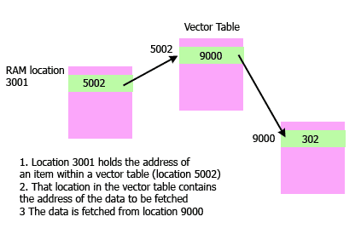
Indirect Addressing
You can think of this like a lookup table.
This lookup table is called a Vector table
You call a location in RAM. Example 3001
That points to the vector table
The vector table points to another location (9000)
Position 9000 actually holds the data (302)

Slide 36
Task
Write your own ASM code.
Use Cambridge’s instruction set.
Your ASM code should include:
Moving data
Input Data
Output Data
Arithmetic Operations (ADD, SUB….)
Unconditional Instructions (Sequence)
Conditional Instructions (IF / BRANCH)
Compare instructions
Then I’ll ask you to come up and explain it line-by-line
It should be based on a two pass assembler so I want to see a OPCODE table, SYMBOL Table and VALUES table also.

